Slide 1
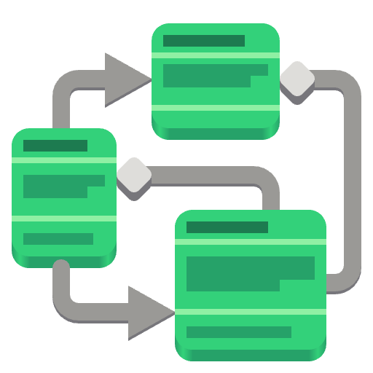

Automating MBSE Models with Gaphor and Python

Slide 2
Model-Based Systems Engineering
The formalized application of modeling to support system requirements, design, analysis, verification and validation activities beginning in the conceptual design phase and continuing throughout development and later life cycle phase (INCOSE)

Slide 3
MBSE is Rigorous Engineering
﻿﻿Language
﻿﻿Abstraction
﻿﻿Automation

Slide 4
Automation
﻿﻿Automated systems have highly repeatable effects
﻿﻿Automatically validate designs for quality and consistency

Slide 5
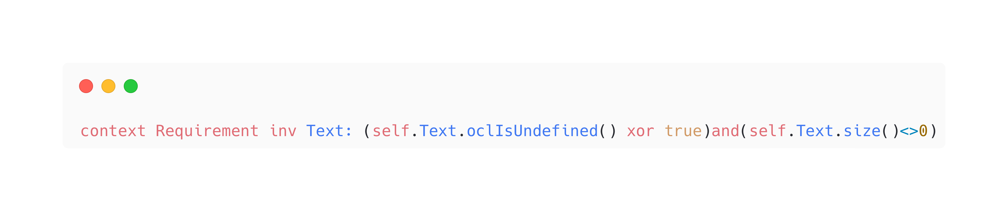
Object Constraint Language (OCL)
It is common to use OCL to check a model for correctness and completeness
It is very powerful, but also a bit terse

Slide 6
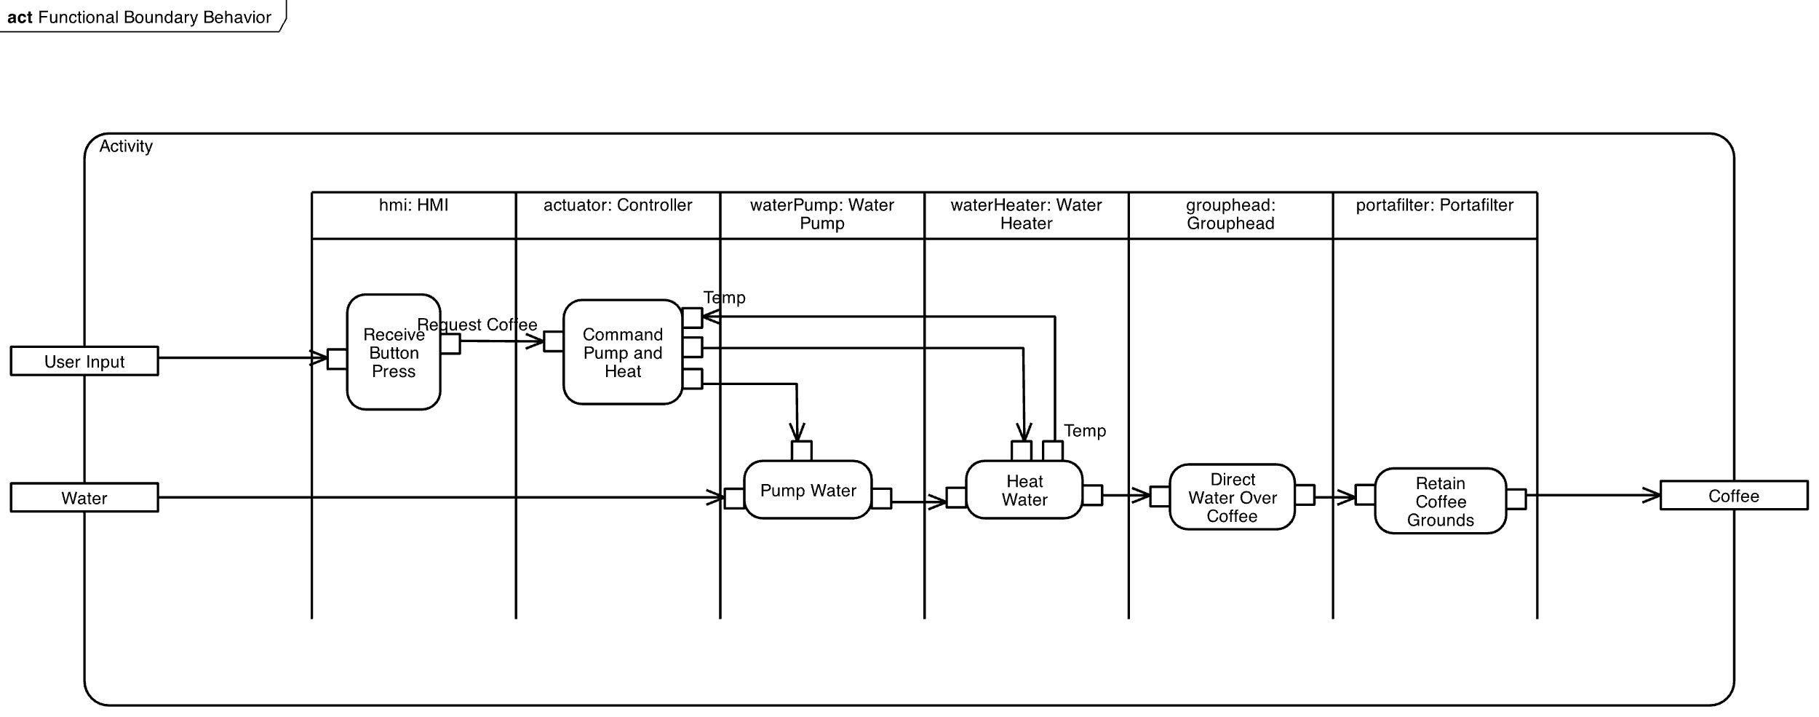
Automation: Create Requirements for Activities

Slide 7
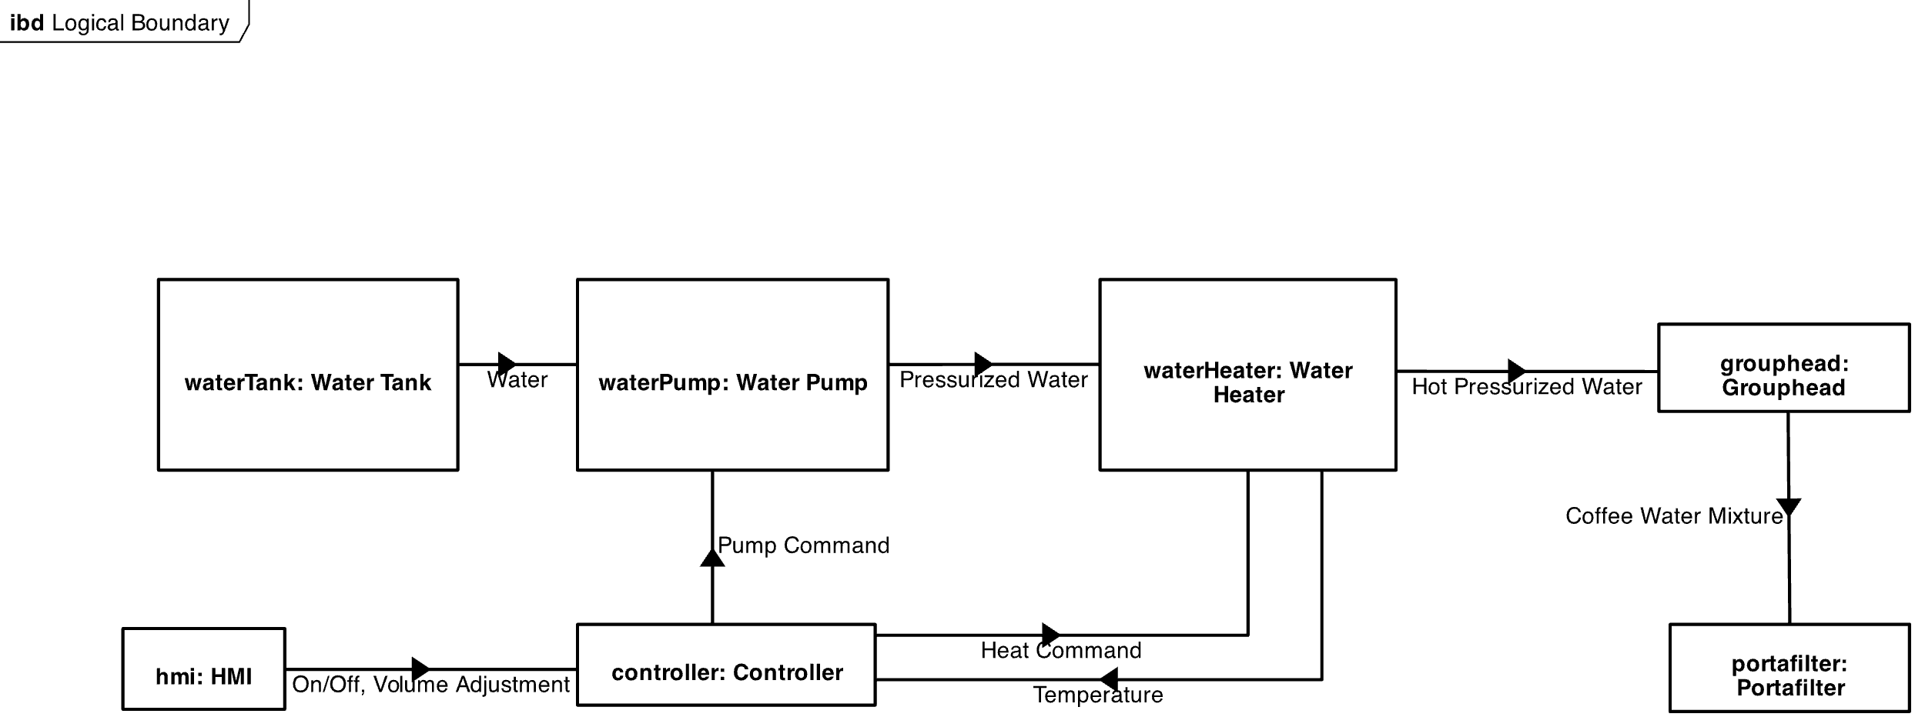
Correctness: All Requirements Satisfied By a Block

Slide 8
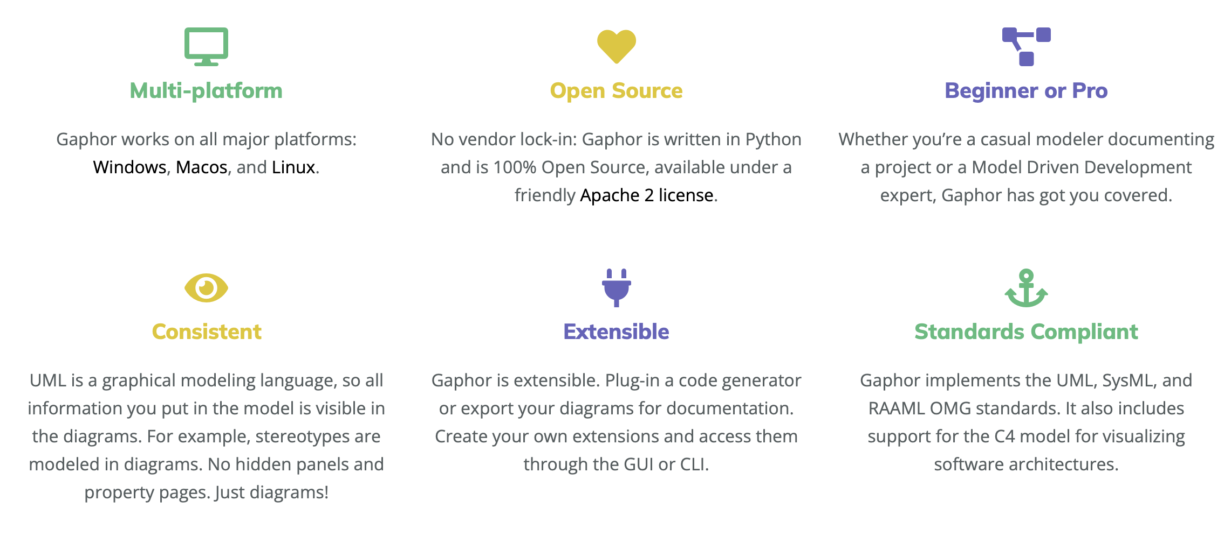
Gaphor is a MBSE Tool

Slide 9

Gaphor Runs on GTK
Originally created as the GIMP toolkit, very popular for Linux app development and basis for GNOME
Full featured GUI toolkit
A little harder to get setup in Windows

Slide 10

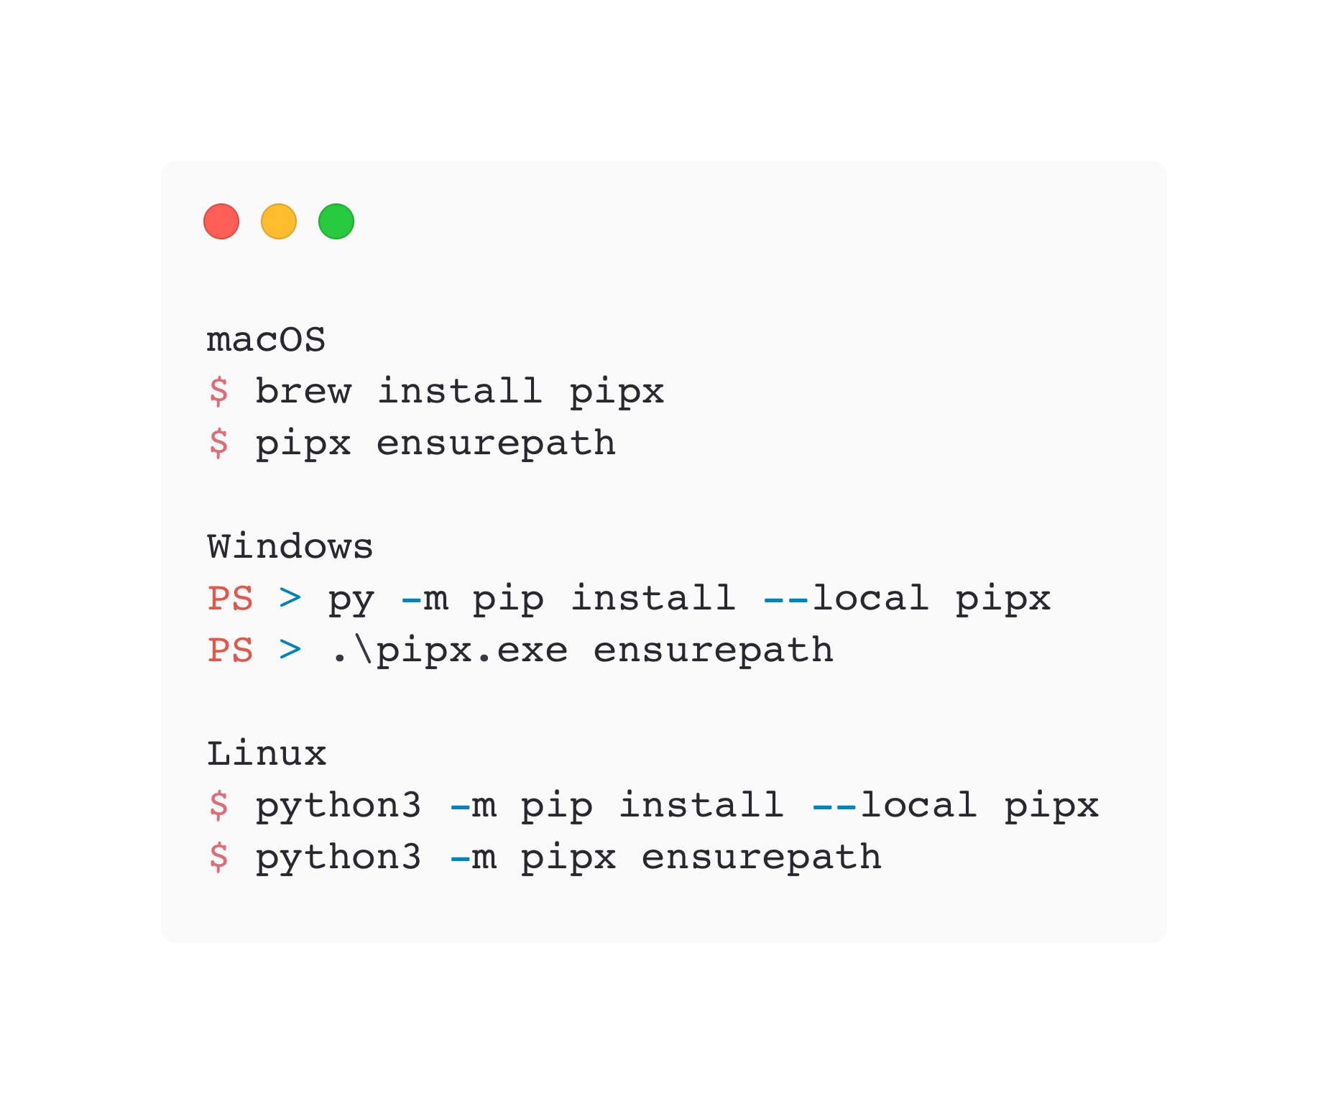
Install pipx

Slide 11

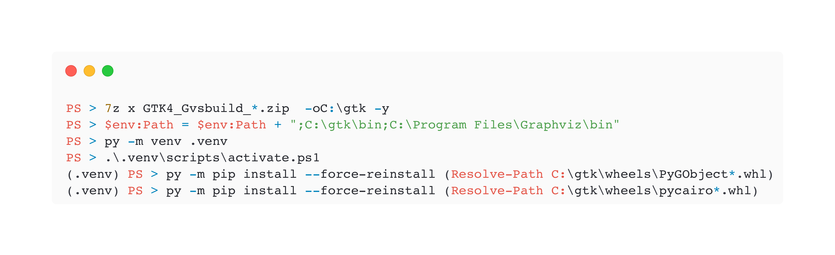
Windows with Gvsbuild
Download the latest GTK4 Gvsbuild from https://github.com/wingtk/gvsbuild
Then execute from PowerShell:

Slide 12

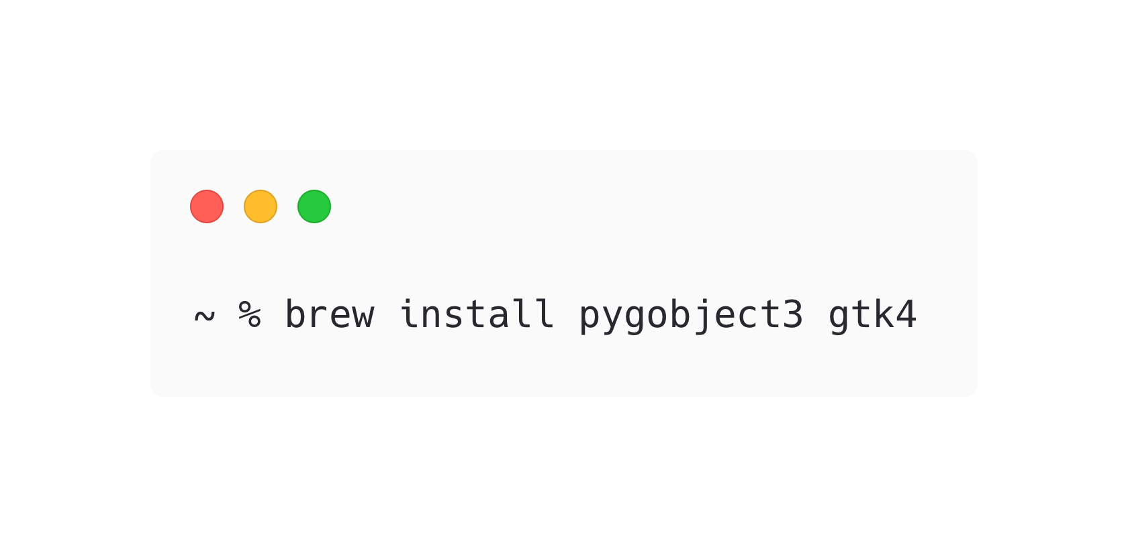
macOS

Slide 13

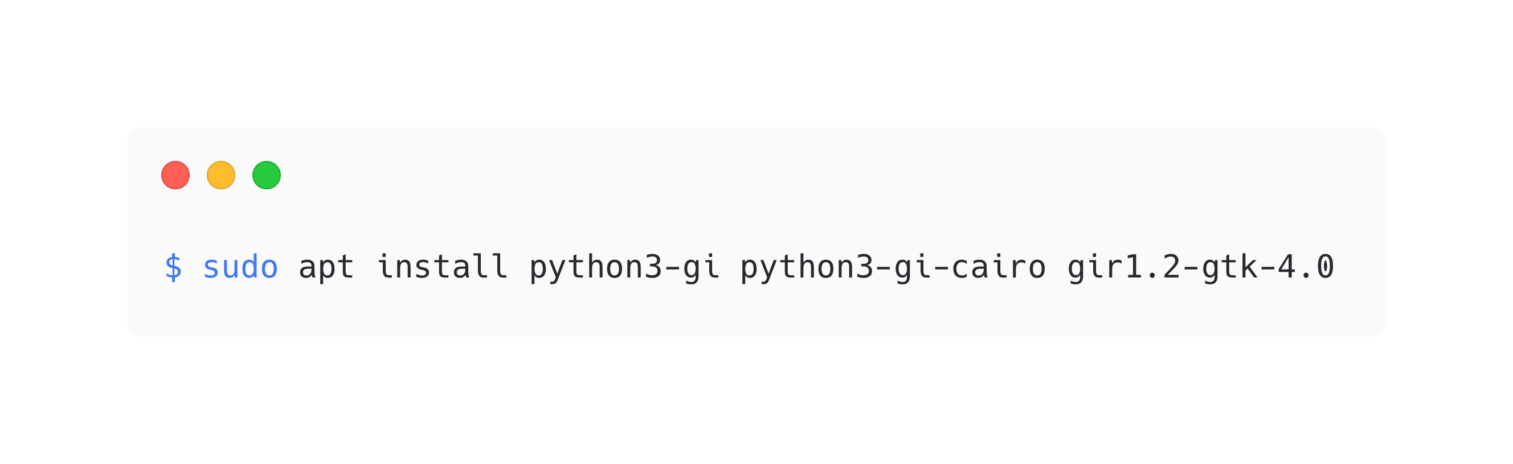
Linux

Slide 14
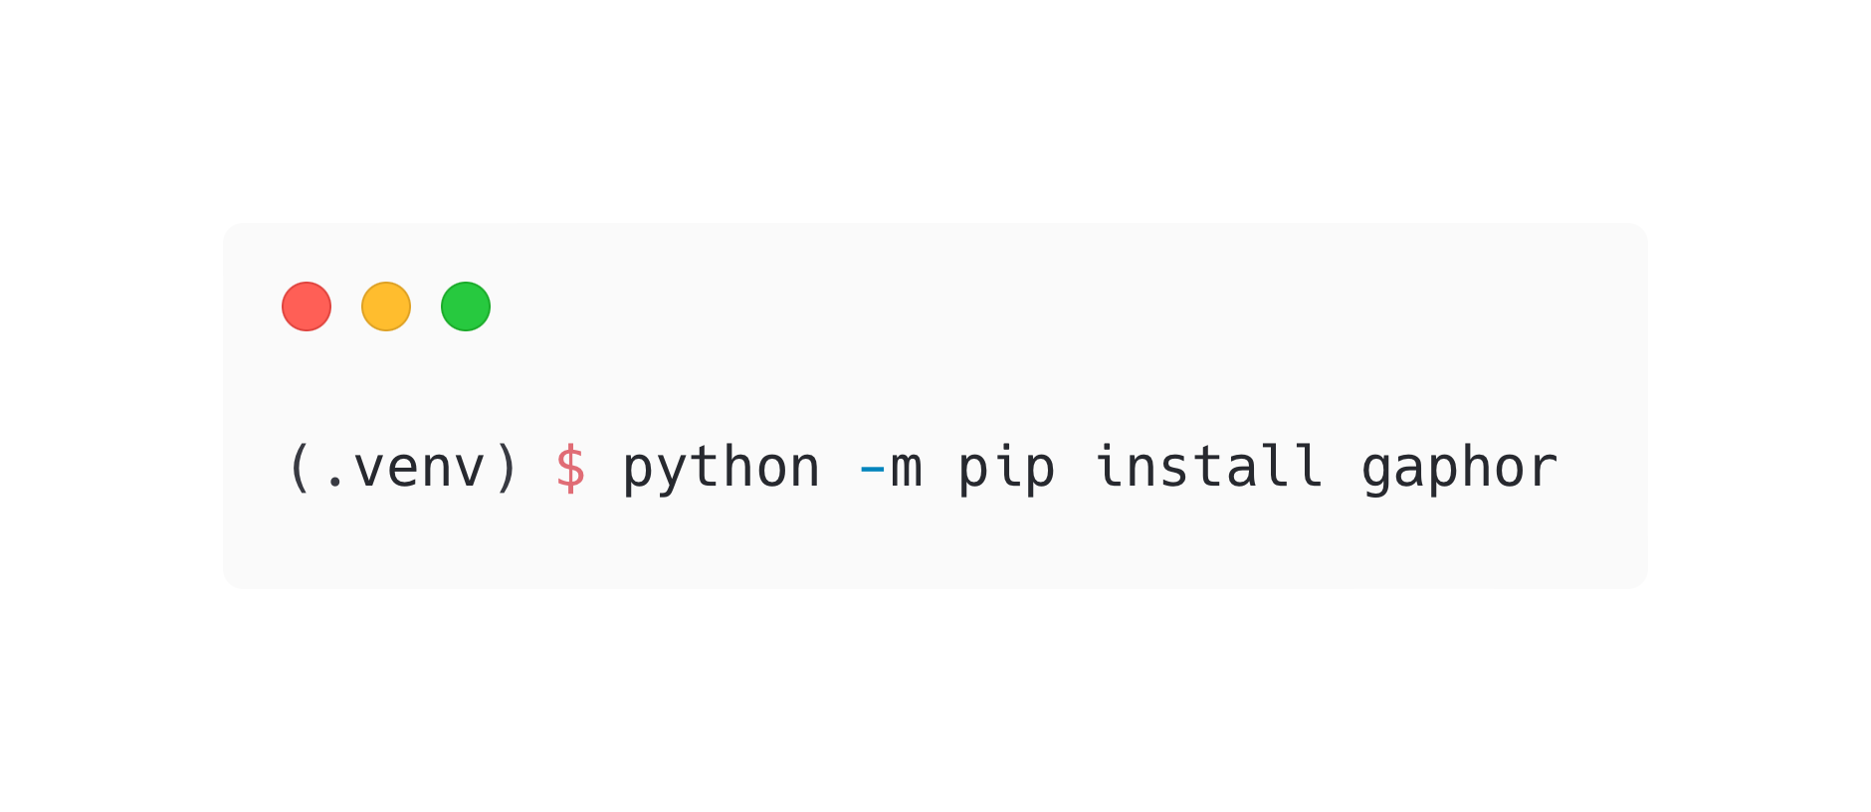
Install Gaphor

Slide 15
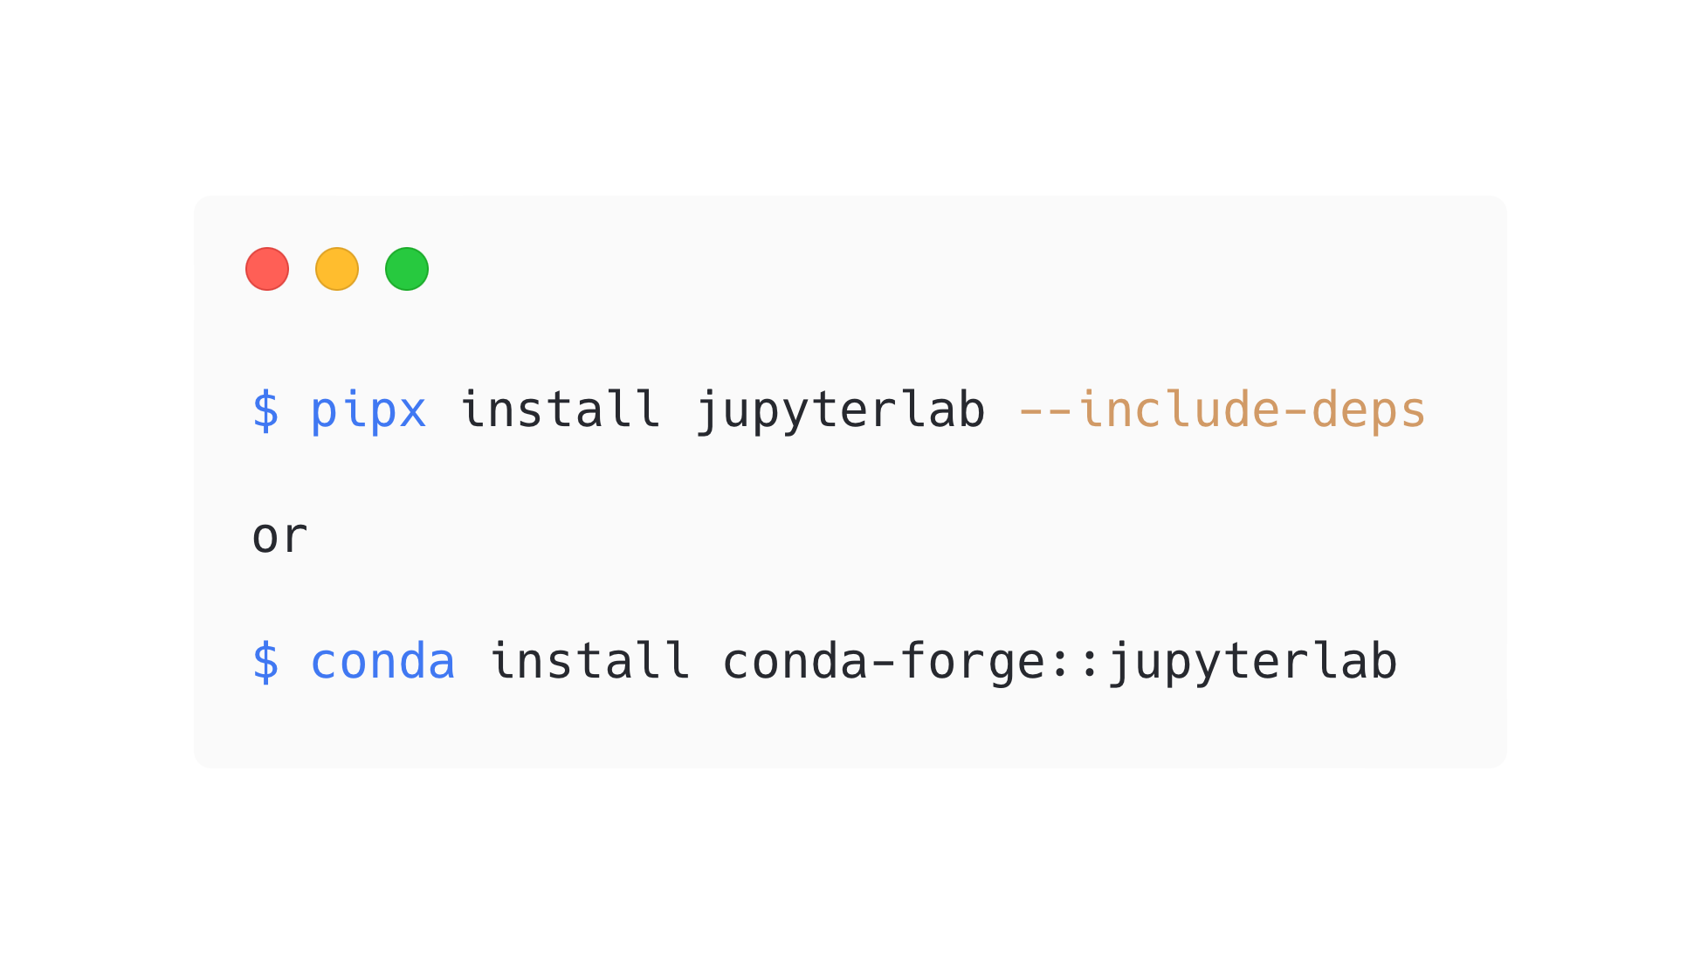

Install Jupyter

Slide 16
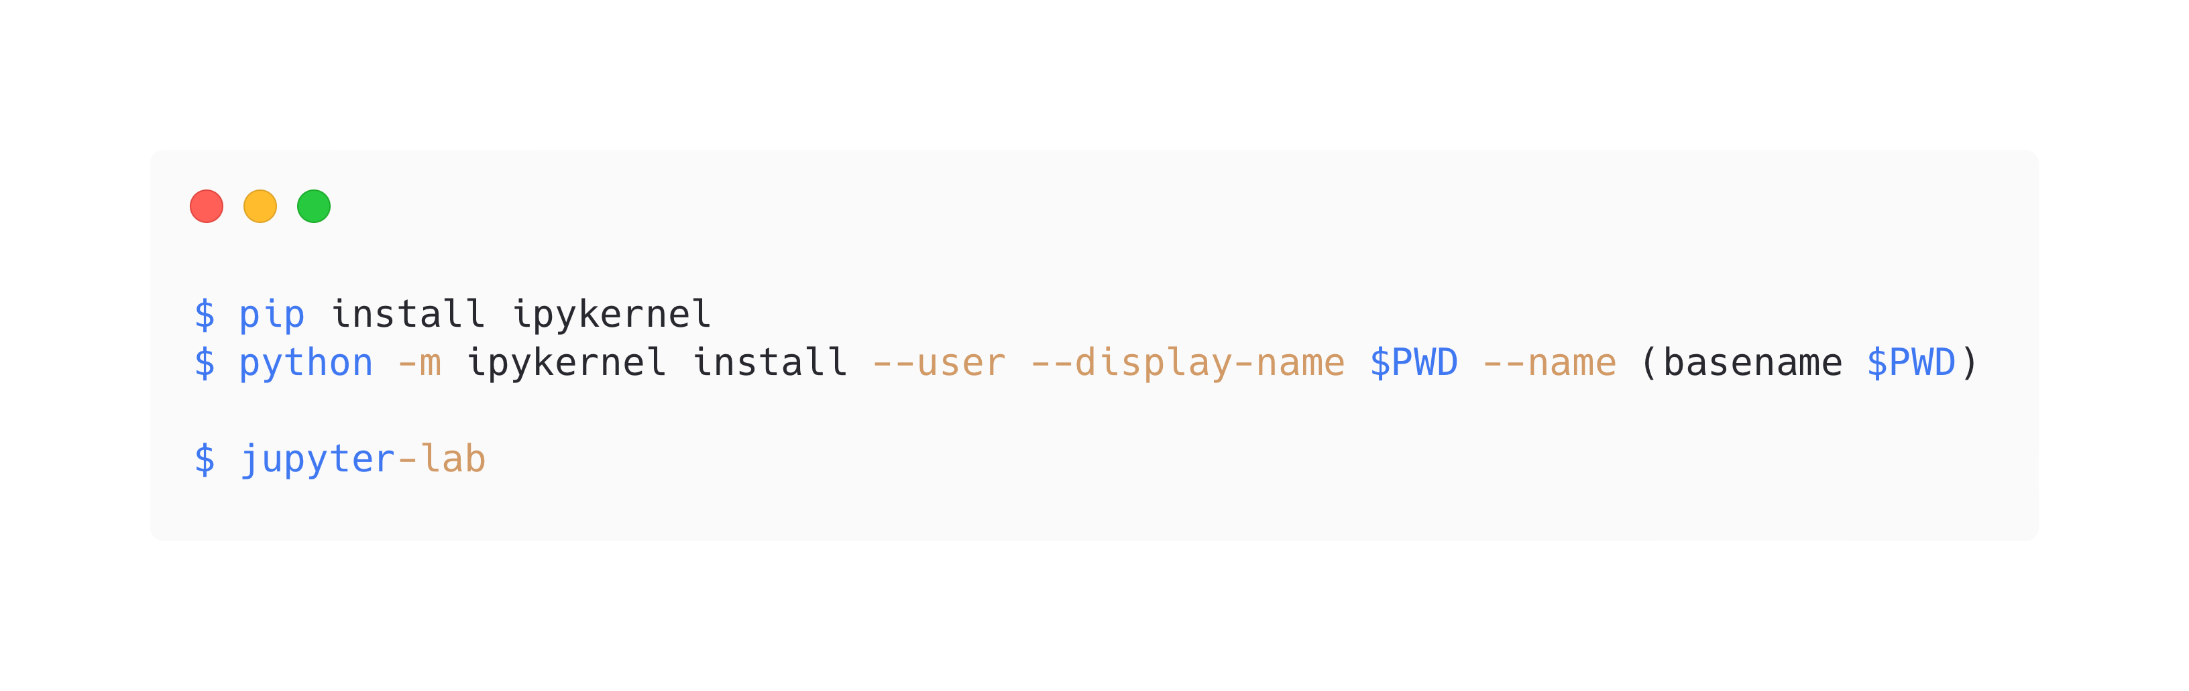
Launch Jupyter Lab

Slide 17
Demo

Slide 18

For More Information
https://docs.gaphor.org/en/latest/scripting.html

Slide 19

Questions?

